Slide 1
Virtual Functions and Abstract Classes in C++

Slide 2
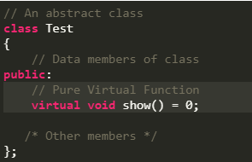
Abstract Classes
An abstract class is, conceptually, a class that cannot be instantiated and is usually implemented as a class that has one or more pure virtual (abstract) functions.
Syntax:

Slide 3
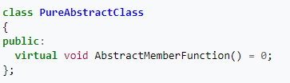
Pure Abstract Classes
An abstract class is one in which there is a declaration but no definition for a member function. The way this concept is expressed in C++ is to have the member function declaration assigned to zero.
And the function declared is pure virtual function.

Slide 4
Example:
A pure virtual function is implemented by classes which are derived from a Abstract class. Following is a simple example to demonstrate the same.

Slide 5
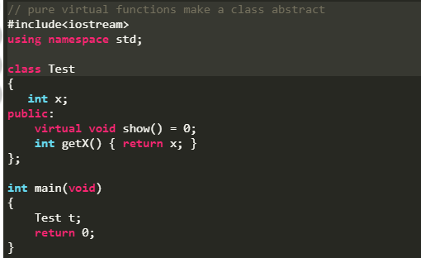
In the following example, Test is an abstract class because it has a pure virtual function show().

Slide 6
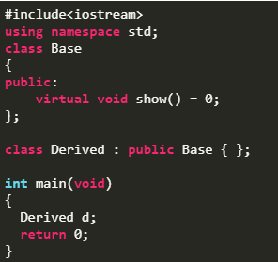
Important
If we do not override the pure virtual function in derived class, then derived class also becomes abstract class.
We can also use constructors with abstract class.

Slide 7
THANK YOU

